Slide 1

CTeSP Tecnologias e Programação de Sistemas de Informação
Segurança Informatica
Filipe André Martins de Freitas

Slide 2
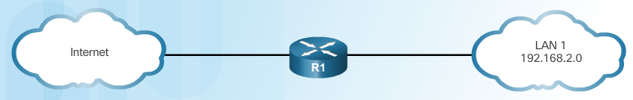
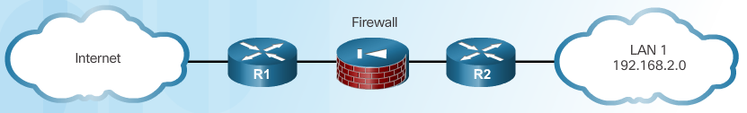
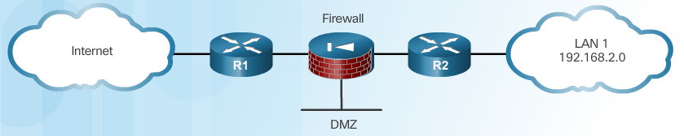
Edge Router Security Approaches
Single Router Approach
Defense in Depth Approach
DMZ Approach
Notes:
2.1.1.2 Edge Router Security Approaches

Slide 3
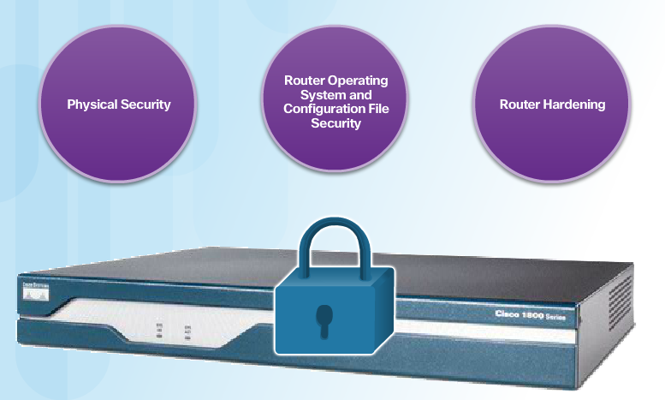
Three Areas of Router Security
Notes:
2.1.1.3 Three Areas of Router Security

Slide 4
Secure Administrative Access
Tasks:
Restrict device accessibility
Log and account for all access
Authenticate access
Authorize actions
Present legal notification
Ensure the confidentiality of data
Notes:
2.1.1.4 Secure Administrative Access

Slide 5
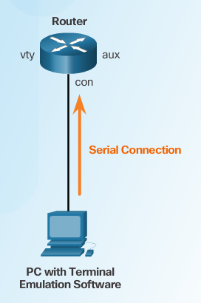
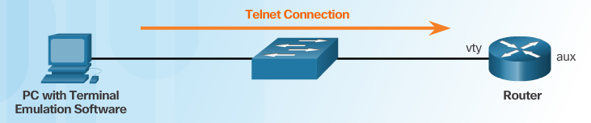
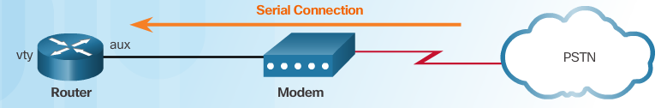
Secure Local and Remote Access
Local Access
Remote Access Using Telnet
Remote Access Using Modem and Aux Port
Notes:
2.1.1.5 Secure Local and Remote Access

Slide 6
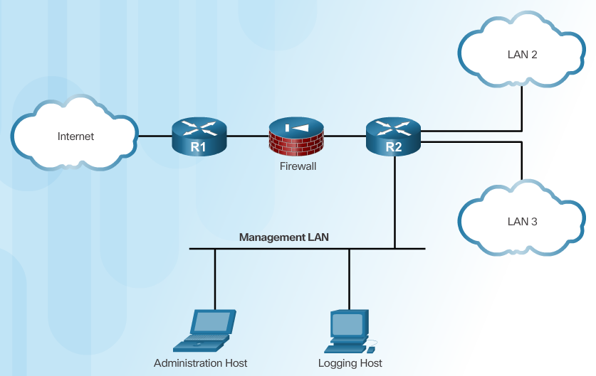
Secure Local and Remote Access (Cont.)
Dedicated Management Network
Notes:
2.1.1.5 Secure Local and Remote Access

Slide 7
Strong Passwords
Guidelines:
Use a password length of 10 or more characters.
Include a mix of uppercase and lowercase letters, numbers, symbols, and spaces.
Avoid passwords based on easily identifiable pieces of information.
Deliberately misspell a password (Smith = Smyth = 5mYth).
Change passwords often.
Do not write passwords down and leave them in obvious places.
Weak Password | Why it is Weak | Strong Password | Why it is Strong
secret | Simple dictionary password | b67n42d39c | Combines alphanumeric characters
smith | Mother’s maiden name | 12^h u4@1p7 | Combines alphanumeric characters, symbols, and includes a space
toyota | Make of car
bob1967 | Name and birthday of user
Blueleaf23 | Simple words and numbers
Notes:
2.1.2.1 Strong Passwords

Slide 8
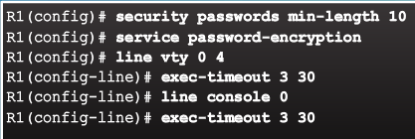
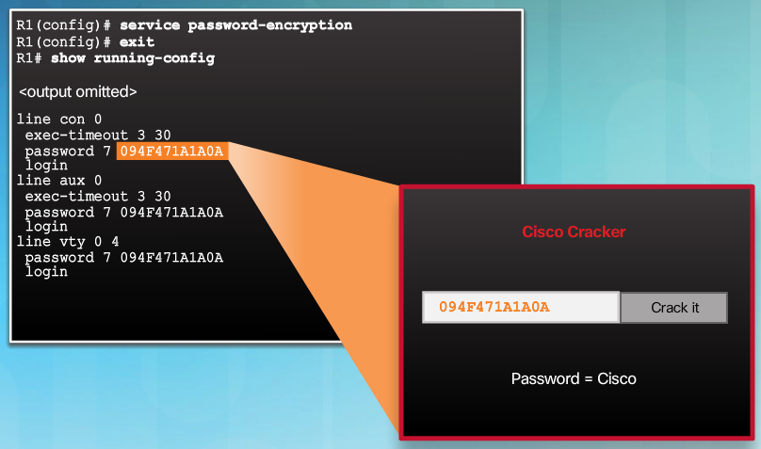
Increasing Access Security
Notes:
2.1.2.2 Increasing Access Security

Slide 9
Secret Password Algorithms
Guidelines:
Configure all secret passwords using type 8 or type 9 passwords
Use the enable algorithm-type command syntax to enter an unencrypted password
Use the username name algorithm-type command to specify type 9 encryption
Notes:
2.1.2.3 Secret Password Algorithms

Slide 10
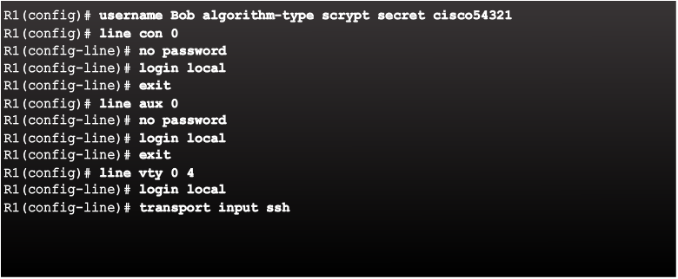
Securing Line Access
Notes:
2.1.2.4 Securing Line Access
Syntax Checker: Secure Administrative Access on R2

Slide 11
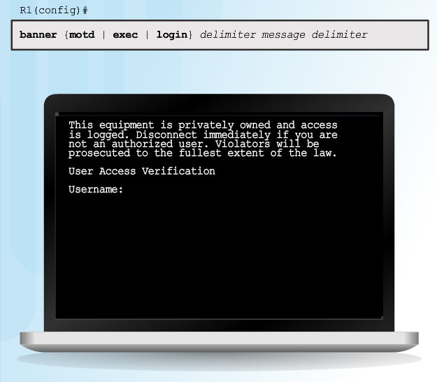
Enhancing the Login Process
Virtual login security enhancements:
Implement delays between successive login attempts
Enable login shutdown if DoS attacks are suspected
Generate system-logging messages for login detection
Notes:
2.1.3.1 Enhancing the Login Process

Slide 12
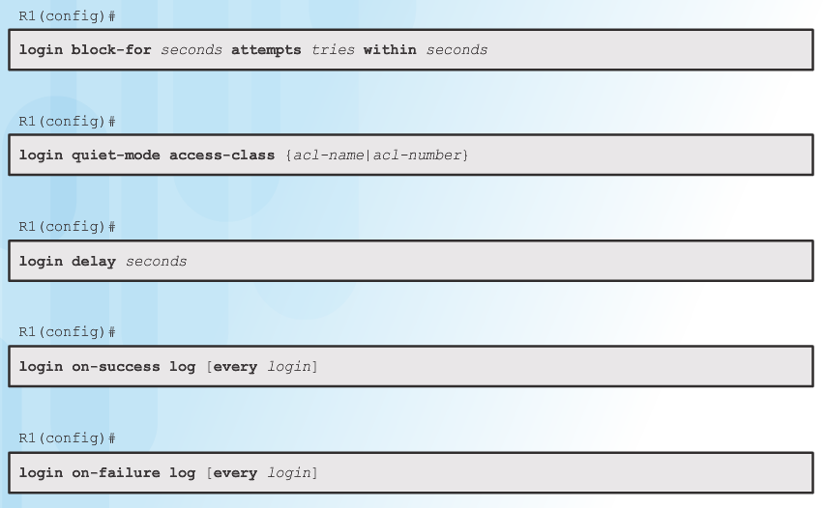
Configuring Login Enhancement Features
Notes:
2.1.3.2 Configuring Login Enhancement Features

Slide 13
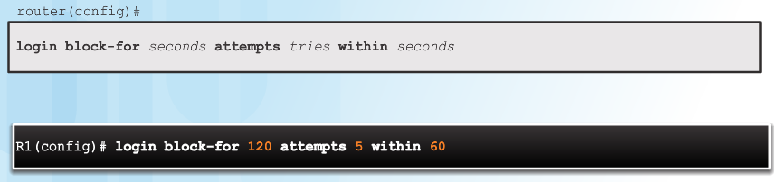
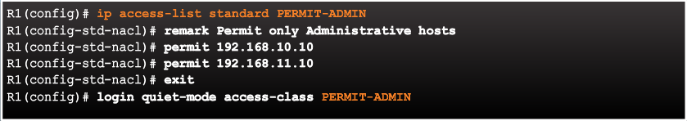
Enable Login Enhancements
Command Syntax: login block-for
Example: login quiet-mode access-class
Example: login delay
Notes:
2.1.3.3 Enable Login Enhancements
Syntax Checker: Configure Enhanced Login Security on R2

Slide 14
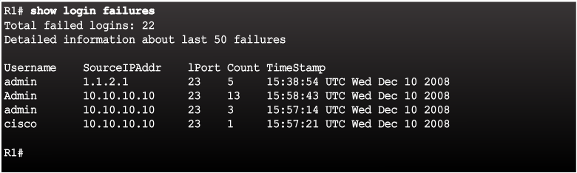
Logging Failed Attempts
Generate Login Syslog Messages
Example: show login failures
Notes:
2.1.3.4 Logging Failed Attempts

Slide 15
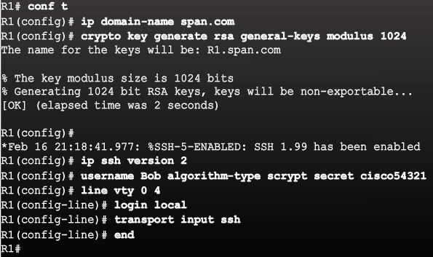
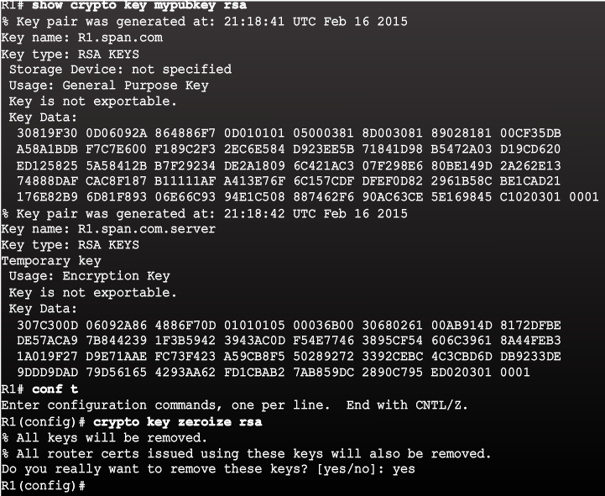
Steps for Configuring SSH
Example SSH Configuration
Example Verification of SSH
Notes:
2.1.4.1 Steps for Configuring SSH

Slide 16
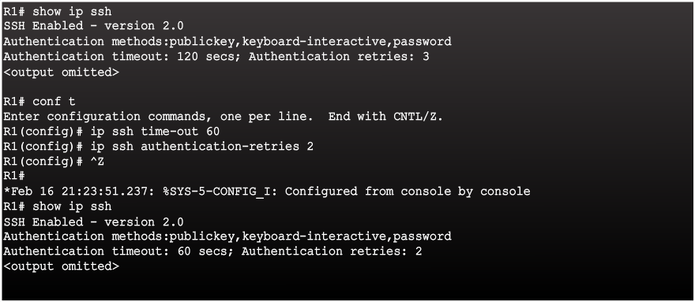
Modifying the SSH Configuration
Notes:
2.1.4.2 Modifying the SSH Configuration
Syntax Checker: Enable SSH on R2

Slide 17
Connecting to an SSH-Enabled Router
Two ways to connect:
Enable SSH and use a Cisco router as an SSH server or SSH client.
  As a server, the router can accept SSH client connections
  As a client, the router can connect via SSH to another SSH-enabled router
Use an SSH client running on a host, such as PuTTY, OpenSSH, or TeraTerm.
Notes:
2.1.4.3 Connecting to an SSH-Enabled Router

Slide 18
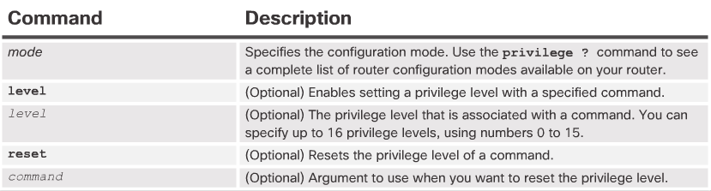
Limiting Command Availability
Privilege levels:
Level 0: Predefined for user-level access privileges.
Level 1: Default level for login with the router prompt.
Level 2-14: May be customized for user-level privileges.
Level 15: Reserved for the enable mode privileges.
Levels of access commands:
User EXEC mode (privilege level 1)
  Lowest EXEC mode user privileges
  Only user-level command available at the router> prompt
Privileged EXEC mode (privilege level 15)
  All enable-level commands at the router# prompt
Privilege Level Syntax
Notes:
2.2.1.1 Limiting Command Availability

Slide 19
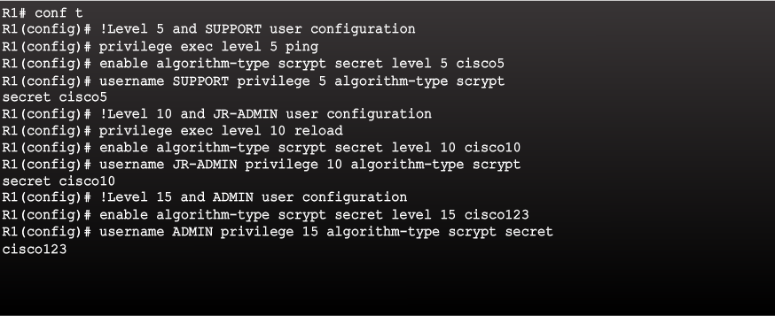
Configuring and Assigning Privilege Levels
Notes:
2.2.1.2 Configuring and Assigning Privilege Levels

Slide 20
Limitations of Privilege Levels
No access control to specific interfaces, ports, logical interfaces, and slots on a router
Commands available at lower privilege levels are always executable at higher privilege levels
Commands specifically set at higher privilege levels are not available for lower privilege users
Assigning a command with multiple keywords allows access to all commands that use those
Notes:
2.2.1.3 Limitations of Privilege Levels
Syntax Checker: Configure Privilege Levels on R2

Slide 21
Role-Based CLI Access
For example:
Security operator privileges
  Configure AAA
  Issue show commands
  Configure firewall
  Configure IDS/IPS
  Configure NetFlow
WAN engineer privileges
  Configure routing
  Configure interfaces
  Issue show commands
Notes:
2.2.2.1 Role-Based CLI Access

Slide 22
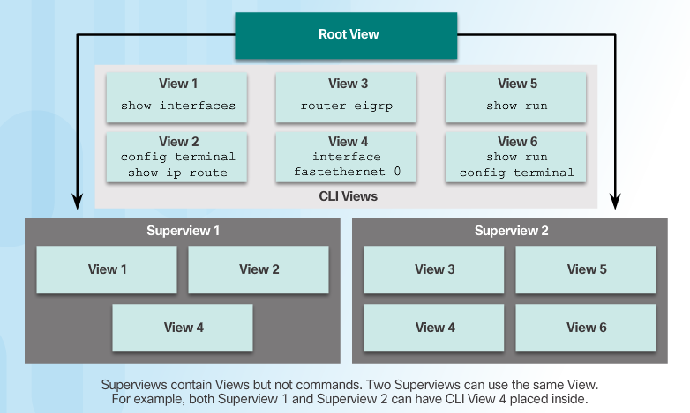
Role-Based Views
Notes:
2.2.2.2 Role-Based Views

Slide 23




Configuring Role-Based Views
Step 1
Step 2
Step 3
Step 4
Notes:
2.2.2.3 Configuring Role-Based Views
Syntax Checker: Configure Views on R2

Slide 24



Configuring Role-Based CLI Superviews
Step 1
Step 2
Step 3
Notes:
2.2.2.4 Configuring Role-Based CLI Superviews
Syntax Checker: Configure Superviews on R2

Slide 25
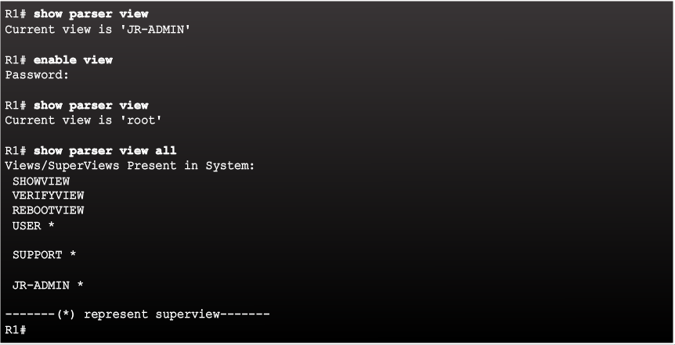
Verify Role-Based CLI Views
Enable Root View and Verify All Views
Notes:
2.2.2.5 Verify Role-Based CLI Views

Slide 26
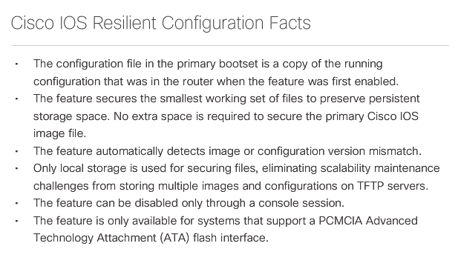
Cisco IOS Resilient Configuration Feature
Notes:
2.3.1.1 Cisco IOS Resilient Configuration Feature

Slide 27
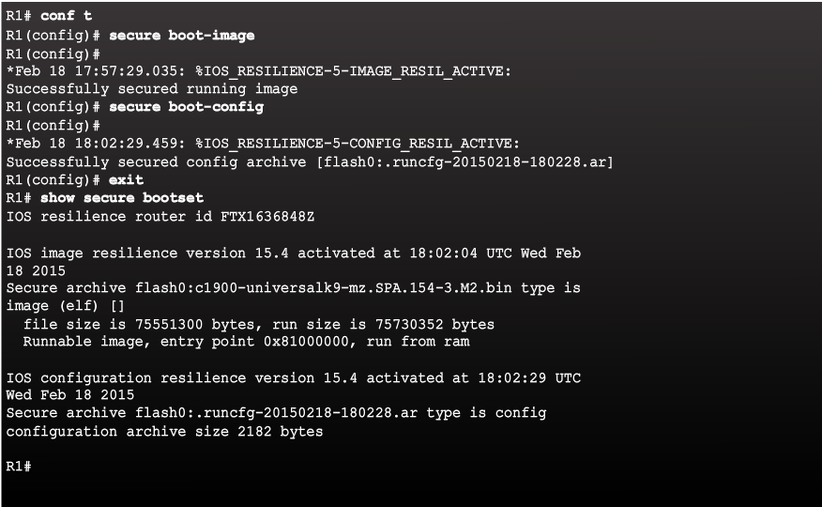
Enabling the IOS Image Resilience Feature
Notes:
2.3.1.2 Enabling the IOS Image Resilience Feature

Slide 28
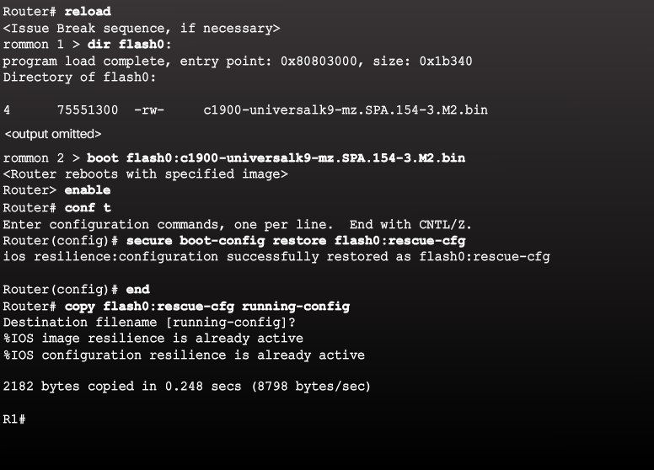
The Primary Bootset Image
Notes:
2.3.1.3 The Primary Bootset Image

Slide 29
Configuring Secure Copy
Configure the router for server-side SCP with local AAA:
Configure SSH
Configure at least one user with privilege level 15
Enable AAA
Specify that the local database is to be used for authentication
Configure command authorization
Enable SCP server-side functionality
Notes:
2.3.1.4 Configuring Secure Copy

Slide 30
Recovering a Router Password
Connect to the console port.
Record the configuration register setting.
Power cycle the router.
Issue the break sequence.
Change the default configuration register with the confreg 0x2142 command.
Reboot the router.
Press Ctrl-C to skip the initial setup procedure.
Put the router into privileged EXEC mode.
Copy the startup configuration to the running configuration.
Verify the configuration.
Change the enable secret password.
Enable all interfaces.
Change the config-register with the config-register configuration_register_setting.
Save the configuration changes.
Notes:
2.3.1.5 Recovering a Router Password

Slide 31
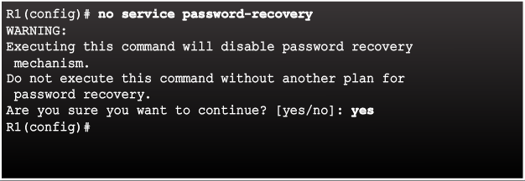
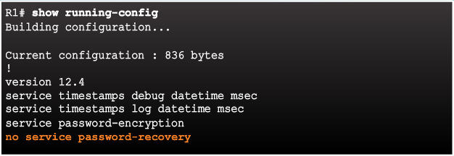
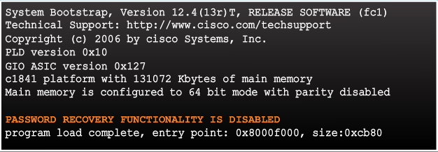
Password Recovery
Disable Password Recovery
No Service Password Recovery
Password Recovery Functionality is Disabled
Notes:
2.3.1.6 Password Recovery

Slide 32
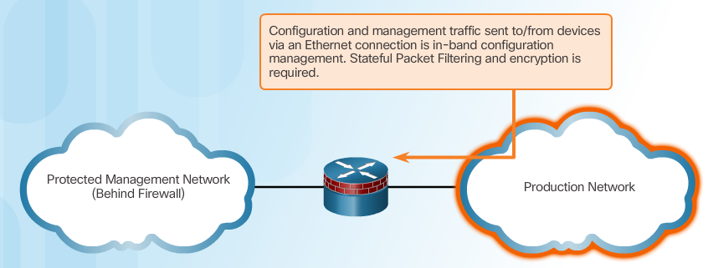
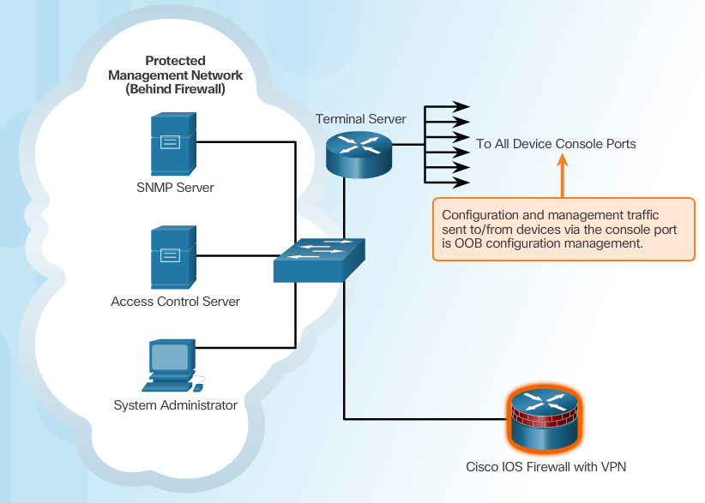
Determining the Type of Management Access
In-Band Management:
Apply only to devices that need to be managed or monitored
Use IPsec, SSH, or SSL when possible
Decide whether the management channel need to be open at all time
Out-of-Band (OOB) Management:
Provide highest level of security
Mitigate the risk of passing management protocols over the production network
Notes:
2.3.2.1 Determining the Type of Management Access
2.3.2.2 Out-of-Band and In-Band Access

Slide 33
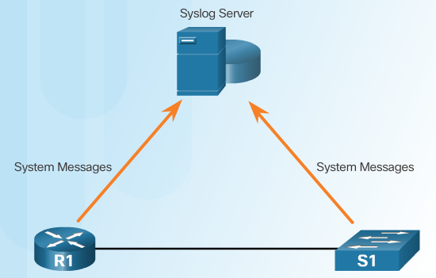
Introduction to Syslog
Notes:
2.3.3.1 Introduction to Syslog

Slide 34
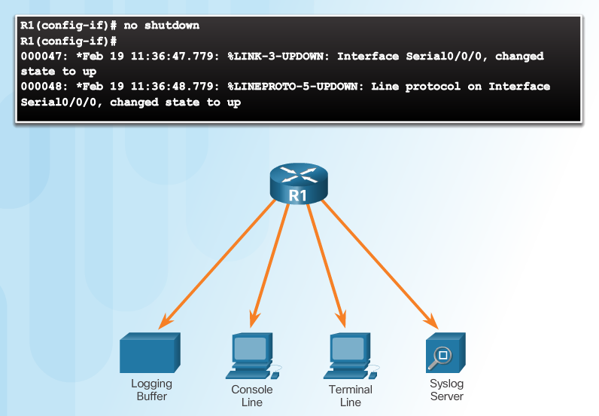
Syslog Operation
Notes:
2.3.3.2 Syslog Operation

Slide 35
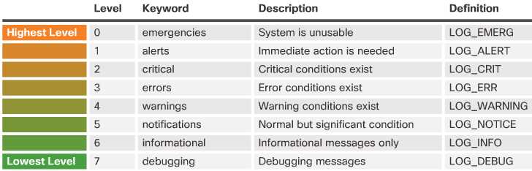
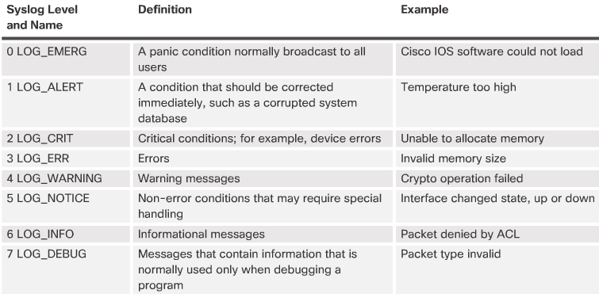
Syslog Message
Security Levels
Example Severity Levels
Notes:
2.3.3.3 Syslog Message

Slide 36
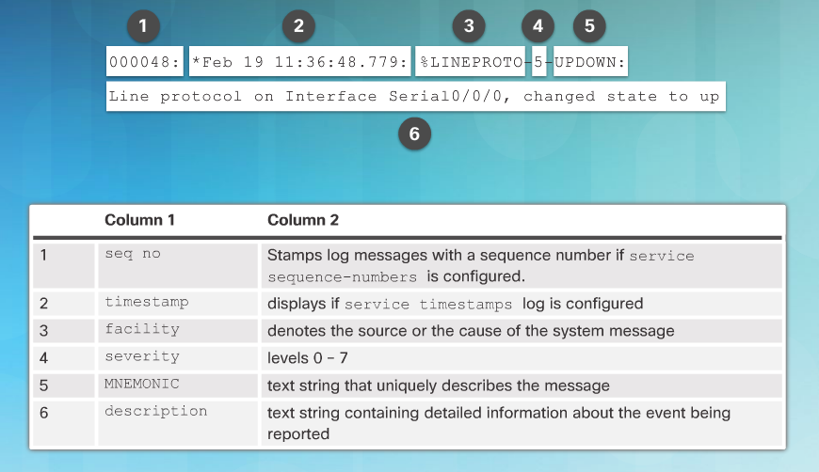
Syslog Message (Cont.)
Notes:
2.3.3.3 Syslog Message
2.3.3.4 Activity - Parts 1-3 : Interpret Syslog Output

Slide 37
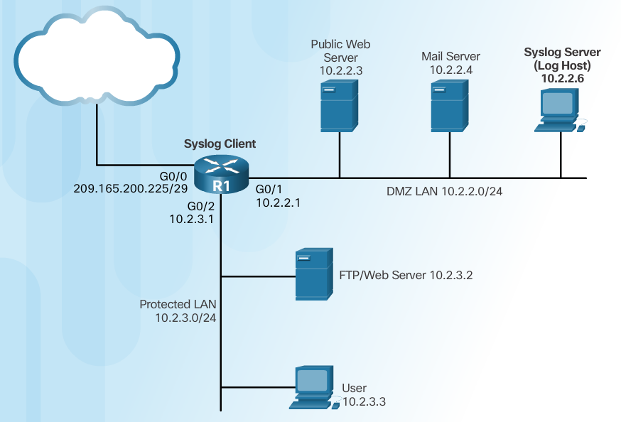
Syslog Systems
Notes:
2.3.3.5 Syslog Systems

Slide 38




Configuring System Logging
Step 1
Step 2 (optional)
Step 3
Step 4
Notes:
2.3.3.6 Configuring System Logging

Slide 39
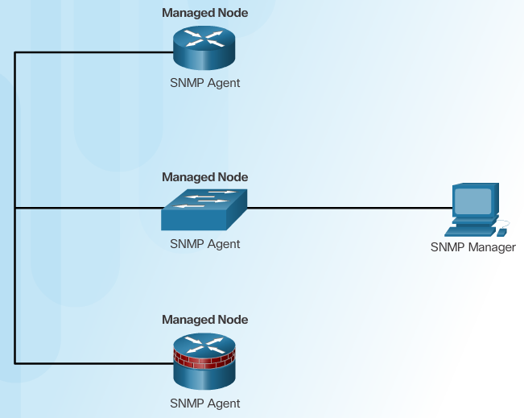
Introduction to SNMP
Notes:
2.3.4.1 Introduction to SNMP

Slide 40
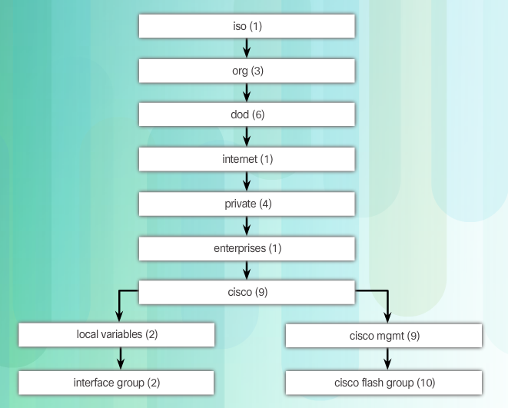
Management Information Base
Cisco MIB Hierarchy
Notes:
2.3.4.2 Management Information Base

Slide 41
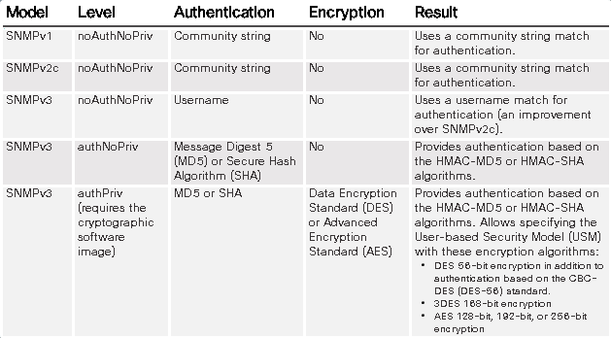
SNMP Versions
Notes:
2.3.4.3 SNMP Versions

Slide 42
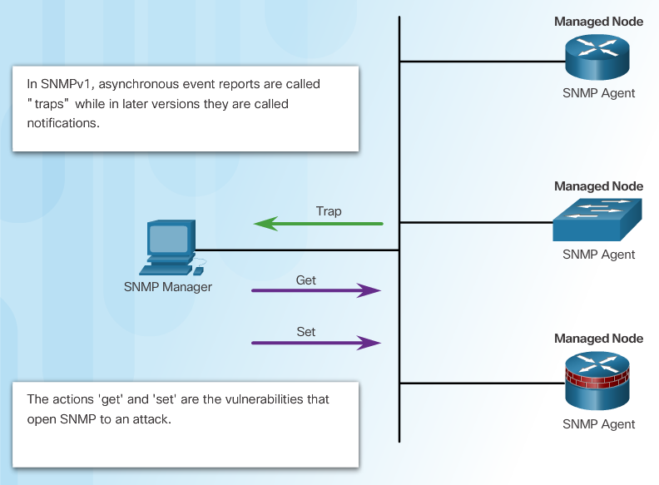
SNMP Vulnerabilities
Notes:
2.3.4.4 SNMP Vulnerabilities

Slide 43
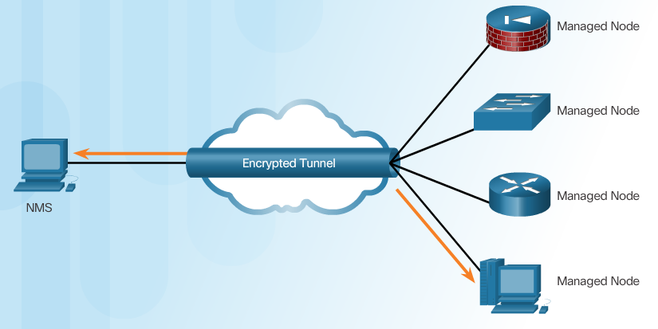
SNMPv3
Message integrity & authentication
Encryption
Access control
Transmissions from manager to agent may be authenticated to guarantee the identity of the sender and the integrity and timeliness of a message.
SNMPv3 messages may be encrypted to ensure privacy.
Agent may enforce access control to restrict each principal to certain actions on specific portions of data.
Notes:
2.3.4.5 SNMPv3

Slide 44
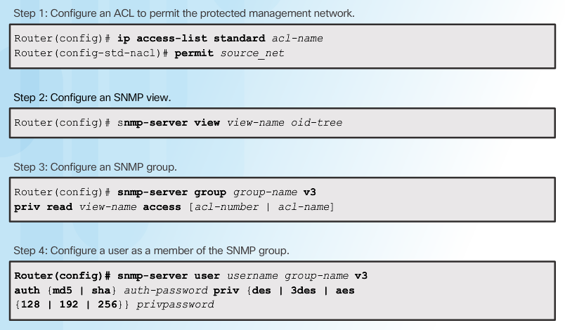
Configuring SNMPv3 Security
Notes:
2.3.4.6 Configuring SNMPv3 Security

Slide 45
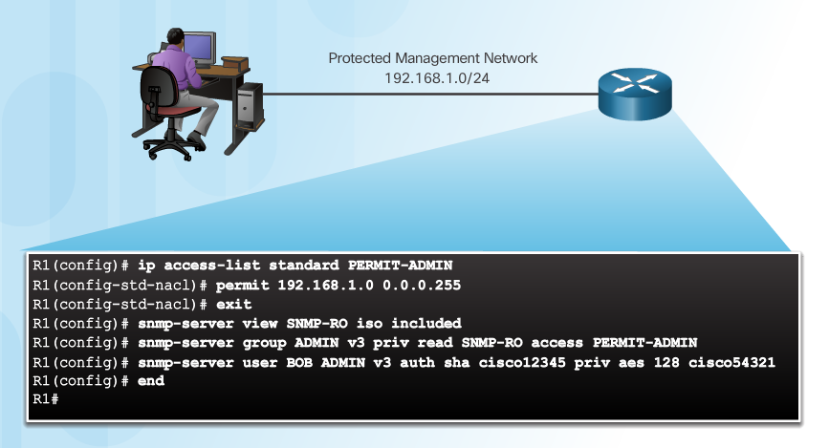
Secure SNMPv3 Configuration Example
Notes:
2.3.4.7 Secure SNMPv3 Configuration Example
Syntax Checker: Configure SNMPv3 Authentication Using an ACL

Slide 46
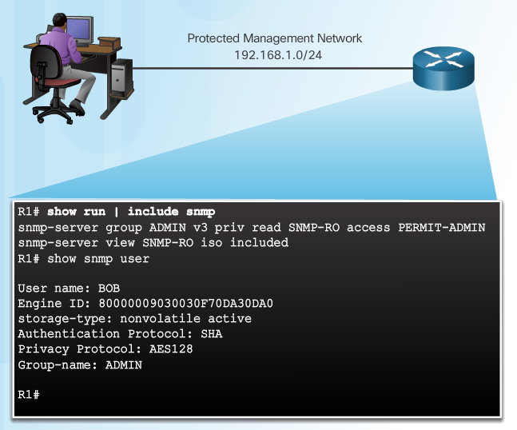
Verifying the SNMPv3 Configuration
Notes:
2.3.4.8 Verifying the SNMPv3 Configuration

Slide 47
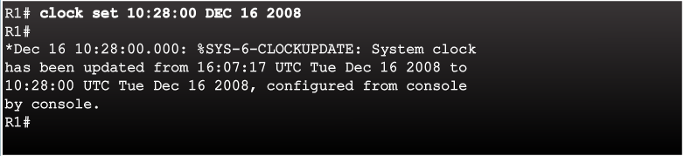
Network Time Protocol
Notes:
2.3.5.1 Network Time Protocol

Slide 48
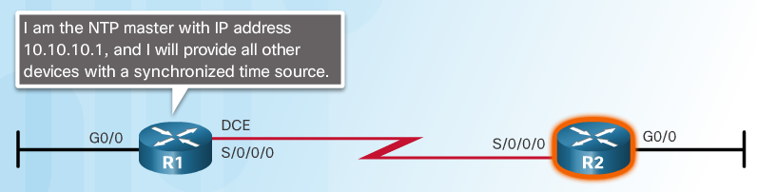
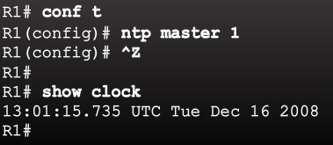
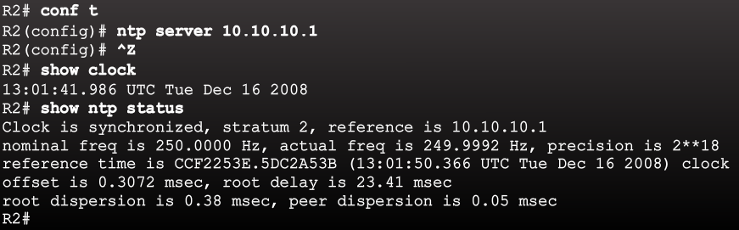
NTP Server
Sample NTP Topology
Sample NTP Configuration on R1
Sample NTP Configuration on R2
Notes:
2.3.5.2 NTP Server

Slide 49
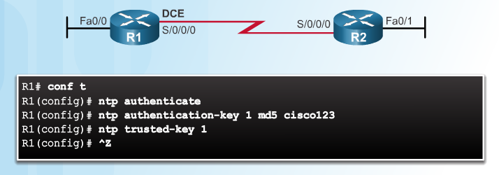
NTP Authentication
Notes:
2.3.5.3 NTP Authentication
Syntax Checker: Configure NTP Authentication on R1

Slide 50
DÚVIDAS ?!

Slide 51


